Slide 1
Bluetooth 4.0

Slide 2
Contents
Overview
Implementation
Uses
Bluetooth vs WiFi
Protocol stack
Setting up

Slide 3

Overview
Invented by telecom vendor Ericsson in 1994
Newest version 4.2
4 classes with different permitted power and range
Notes:
Bluetooth is a wireless technology standard for exchanging data over short distances.

Slide 4
Implementation
Packet-based protocol
Master-slave structure
Operates at frequencies between 2402/2400 and 2480/2483.5 MHz
Guard bands 2MHz wide at the bottom end and 3.5MHz wide at the top

Slide 5
Implementation
Packet-based protocol
Each channel has a bandwidth of 1MHz
Bluetooth transmits each packet on one of 79 designated Bluetooth channels
Bluetooth low energy uses 2MHz spacing, which accommodates 40 channels

Slide 6
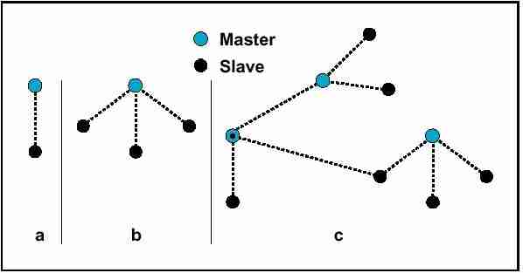
Implementation
Master-slave
A master Bluetooth device can communicate with a maximum of 7 devices
The master switches rapidly from one slave to another in a round-robin fashion
Notes:
piconet

Slide 7
Uses
Class | Maximum permitted power |  | Type range (m)
 | mW | dBm
1 | 100 | 20 | ~100
2 | 2.5 | 4 | ~10
3 | 1 | 0 | ~1
4 | 0.5 | -3 | ~0.5
Version | Data rate
1.2 | 1 Mbit/s
2.0 + EDR | 3 Mbit/s
3.0 + HS | 24 Mbit/s
4.0 | 24 Mbit/s

Slide 8
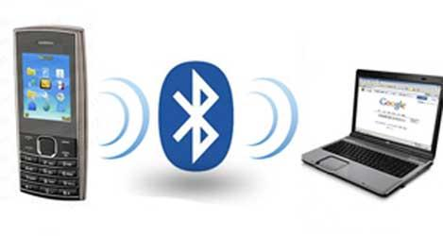
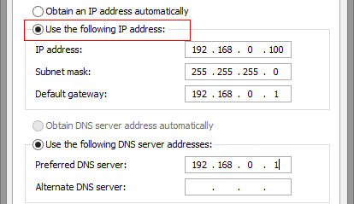
Bluetooth vs WiFi
Bluetooth
Intended for portable equipment and its applications
Connect 2 devices with minimal configuration
Wi-Fi
Intended for general local area network access in work areas
Require high speeds and some degree of client configuration

Slide 9
Setting up
Device name
Device class
List of services
Technical information
Device features
Manufacturer
Specification used
Clock offset

Slide 10
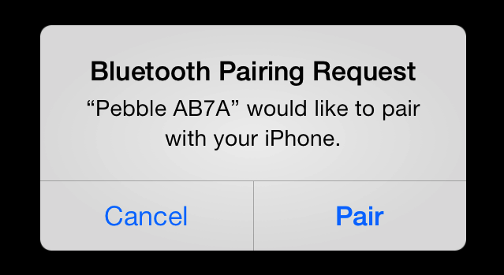
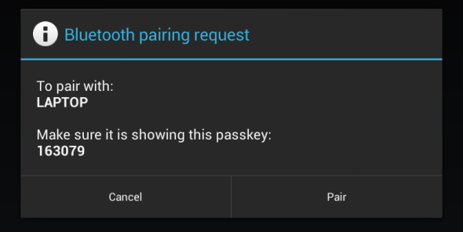
Setting up
Paring
LINK KEY
Friendly name
Notes:
Every device has a unique 48-bit address. These addresses are generally not shown in inquiries. Instead, friendly Bluetooth names are used, which can be set by the user
During pairing, the two devices establish a relationship by creating a shared secret known as a link key. If both devices store the same link key, they are said to be paired or bonded.

